Slide 1
CSCI 2200: Intro to Unix Files

Slide 2


CRITICAL KNOWLEDGE!
It is essential for you to understand the file system structure!
Before you can use a resource, you must be able to locate the resource
/
/
/
/
/
/
/
/
FILE
PATH
The path defines a namespace
This is why we can have many files with the same name (e.g., index.php) in the same file system

Slide 3
Unix File Types (Review)
Unix file systems recognize seven basic types of file system objects
directories
regular files
character special files
block special files
symbolic links
pipes (FIFOs)
sockets

Slide 4
Unix File Types (Review)
File systems don't distinguish between regular file formats, treating text files, source files, object files, and so forth as regular files
This differs from Windows, which
treats file extensions as an indicator of regular file type,
associating specific applications with specific extensions

Slide 5
Unix Regular File Typing
Unix applications and convention do provide two forms of weak support for associating regular files with formats:
Some applications generate special header content, known as "magic numbers", for tagging their outputs
This content is used by the file command (described later) to make educated guesses about a file's format
Unix users have historically used certain extensions as de facto standards for naming formats in certain formats

Slide 6
Unix File Extension Conventions (selected)
.txt - for text files
.c, .cpp, .f, .py - for C, C++, Fortran, Python source files
.o - for object files
.a - for libraries
.exe – for executables
also common, however, to drop the .exe
compilers, moreover, routinely compiled programs a.out
.

Slide 7

Unix File Extension Conventions (selected)
.gz – for zip files (short for gzip, Unix's file compressor)
.tar – for archives (refers to tar, Unix's archiver)
.tgz – for compressed tar archives
for about 40 more common extensions, see https://kb.iu.edu/d/affo

Slide 8
Unix vs. Windows: Text File Formats
Users routinely edit text files under Windows, then transfer them to Unix – or vice versa – via
cross-text-editor copy-and-paste
file transfer utilities like SFTP and FileZilla
cross-system file browsers like FileCommander (free)
plugins like VisualGDB (commercial), which
integrates with Visual Studio and
allows cross-development for Unix under Windows, including use of the VisualStudio IDE for Linux-based debugging

Slide 9
Text Files: Overview
De facto standard for various content, due to portability
Windows and Unix, however, use different EOL markers
Unix text files map \n to one character: ^J
Windows text files map \n to two: ^M^J
This creates problems for cross-platform development

Slide 10

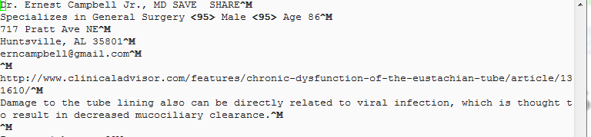
Unix vs. Windows File Formats
Outcome of naïve transfer, DOS to Unix: extra ^M after each line

Slide 11
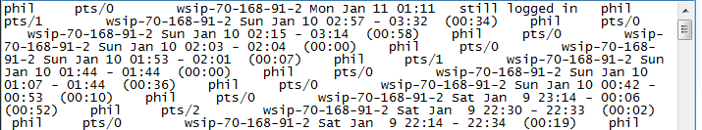
Unix vs. Windows File Formats
Outcome of naïve transfer, Unix to DOS: missing ^J after each line

Slide 12
Unix vs. Windows File Formats
This difference is due to the developers who re-engineered Unix to produce CP/M, DOS's forerunner
Those geniuses added the ^M (carriage return) to Unix's ^J (line feed) to make device drivers for 1970's era printers easier to code
This "trivial" change has plagued succeeding generations of dual-platform users

Slide 13
Unix vs. Windows File Formats
As a rule, transferring text files between Unix and Windows requires adding or removing ^M, depending on the transfer
Unix supplies two utilities for doing the conversions
dos2unix – convert Windows-format text files to Unix format
unix2dos – convert Unix-format text files to Windows format
In Windows, Notepad++'s Edit / EOL Conversion option supports conversions among Unix, Windows, and Mac formats

Slide 14
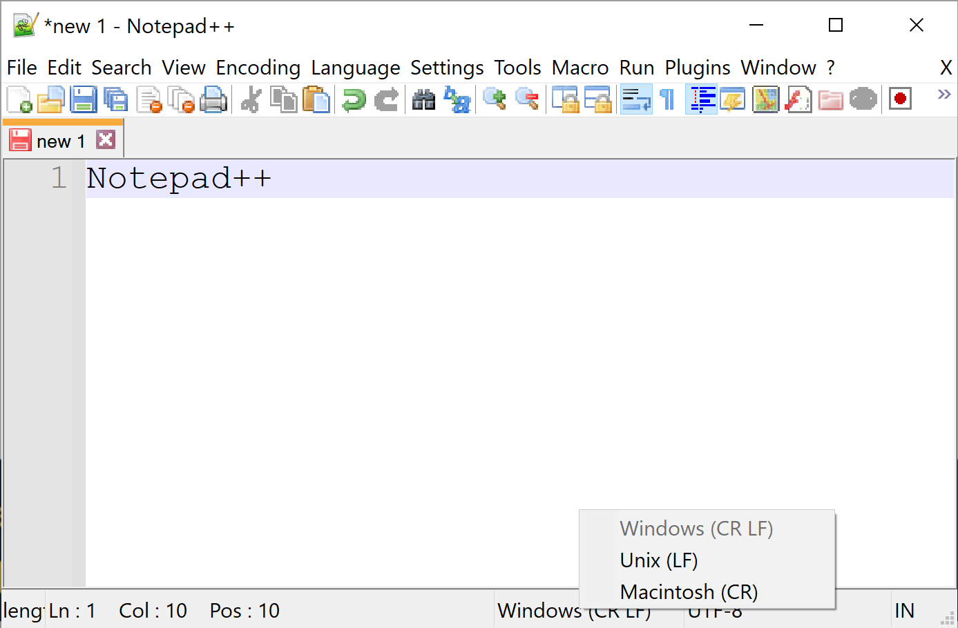

Slide 15
Text Editors

Slide 16
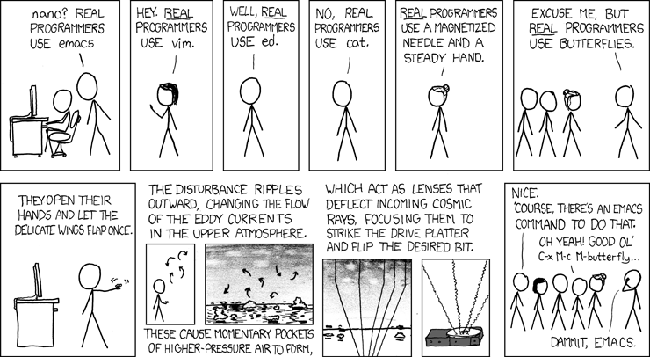
Unix Text Editors

Slide 17
Text Editing under Unix
Lots of editors to choose from, ranging from
the utterly simple to
programmable editors with IDE-like capabilities
Includes
a whole breed of newer generation editors: e.g., GEANY, SCITE, LIME TEXT, SUBLIME TEXT, KATE, ATOM, and Notepadqq (see http://itsfoss.com/notepad-alternatives-for-linux/)
classic standbys: nano, vim, emacs

Slide 18
Unix Text Editors - nano
Simple and functional
most commands are control codes
basic commands shown at all times on bottom of edit buffer
more commands shown on help menu (^G)
users can be productive in seconds
more than adequate for normal editing
for nonstandard editing, consider (e.g.)
entering text using a modeless editor on another platform, then
transferring text to Unix system
Descendant of an older Unix-based KISS text editor, pico
Like notepad and notepad++, a "modeless" editor
by default, type-in goes straight into the edit buffer
Advice: If you’re new to Unix/Linux, start with nano

Slide 19
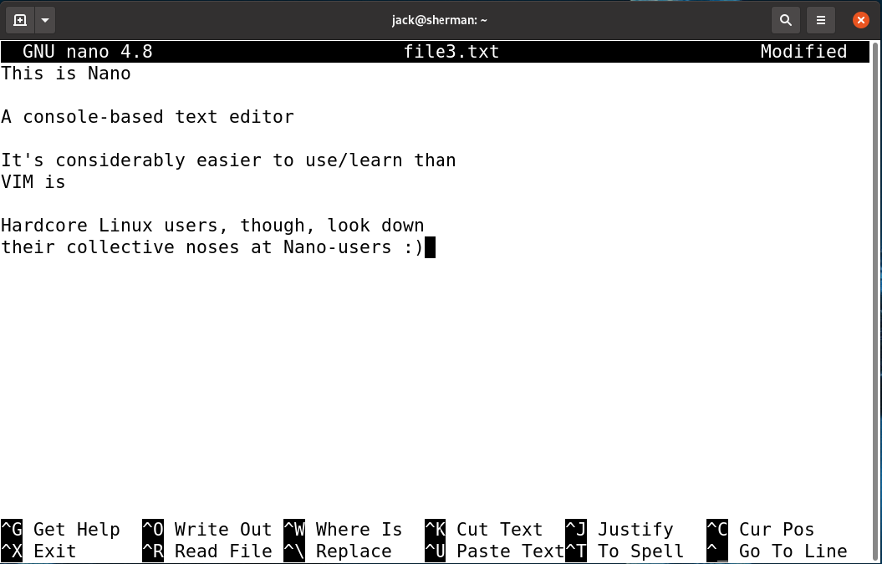

Slide 20
Unix Text Editors - vim
Main minus - high learning curve
alphabet soup commands – effective use requires a fairly wide range of control keys and single letter commands
multimodal – must understand modes and mode switching to get full power and recover from accidental mode switches
Assessment – for hard core coders, old Unix hackers
a lot to take on for 2200
worth learning for longer-term Unix use
Extension of William Joy's vi editor (1976)
On all Unix systems; downlodable for Windows
Highly functional – supports (e.g.)
programmable macros
syntax coloring
control character entry
brace matching
split screen editing
editing inside of archives
plugins

Slide 21
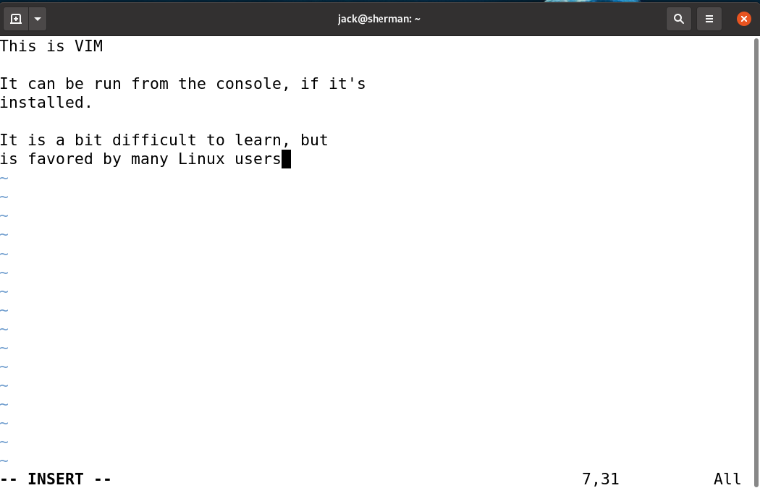

Slide 22

*Note: this screen shot taken from an Ubuntu virtual machine

Slide 23
Files
CRUD - Create, Read, Update, Delete

Slide 24
Ways of Creating Files
using text files to edit files (see notes on text files)
transferring files from Windows to Unix
see supplemental materials on using einstein and notes on text files
touch – create file if nonexistent
cp – make a new copy of an existing file
ln – create shortcuts between items
creating files by I/O redirection
covered in subsequent slideset
N.B.: The term item is used for commands that apply to files as well as directories.

Slide 25
cp: copy file
cp source target
given the requisite permissions to access the files involved, cp creates a copy of a sourcefile source in one of two places
if target didn't exist before executing cp , cp creates a new file, target, with same permissions as source

Slide 26
cp: copy file
cp source target
if target did exist, things get confusing
if target is a file, cp overwrites target with source
if target is a directory
if target/source didn't exist, source is copied to target/source
otherwise, cp fails

Slide 27
cp -i, cp -f, cp -n – managing overwriting
cp -n sourcefile target
non-overwriting copy: never overwriting an existing item
cp -i sourcefile target
interactive copy: ask before overwriting an existing item
cp -f sourcefile target
forcing copy: always overwrite an existing item – don't bother to ask

Slide 28
cp: Pragmatics
If two or more of -i,-f, and -n are specified, only the last specified option takes effect
This "use final option" behavior is useful for overriding aliases: e.g., cp -f always overwrites without asking, even when cp is aliased to cp -i or cp -n

Slide 29
cp: Pragmatics
Accidentally copying a source file into a target directory is a classic mistake
This mistake is confusing but fixable
Accidentally overwriting an existing file is another classic mistake
Without backup, this mistake is not fixable
Unless you mean to copy a file into a directory or overwrite a file, verify that the target's absence before executing cp

Slide 30
Ways of Reading Files
using text editors to view a text file's contents (see text file notes)
ls – view an item's attributes
stat – view an item's attributes in greater detail than shown by ls (outside scope of 2200)
getfacl – view an item's ACL (outside scope of 2200)
N.B.: The term item is used for commands that apply to files as well as directories

Slide 31
Ways of Reading Files
using text editors to view a text file's contents (see text file notes)
file – determine an item's type
cat – view a (text) file's contents
more – view a (text) file's contents, with support for pagination and searching of long files
less – more fully featured replacement for more
grep – search a file for content (covered later in course)
N.B.: The term item is used for commands that apply to files as well as directories

Slide 32
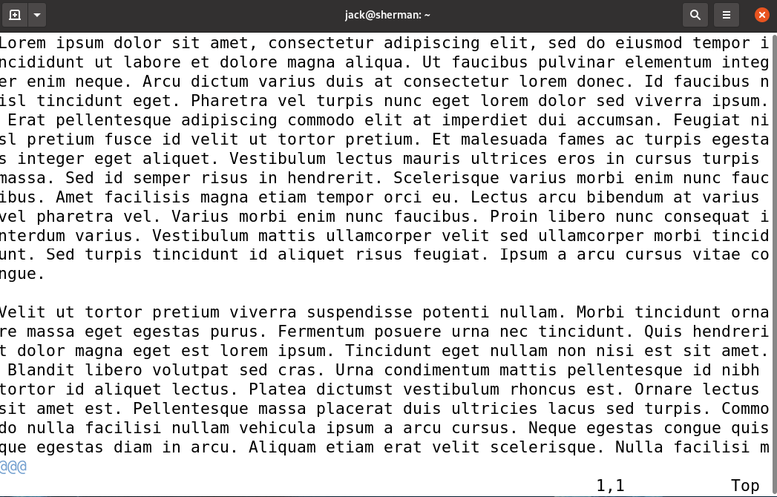
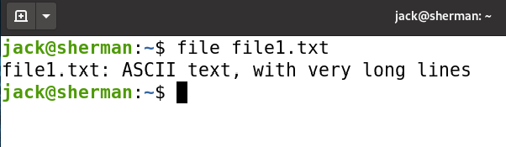
Ways of Reading Files

Slide 33
Ways of Updating Files
using text files to update files (see notes on text files)
mv – move/rename an item
chmod – change an item's permissions
chown – change an item's owner and/or group
chgrp – change an item's group
setfacl – change item's ACL (outside scope of 2200)
touch – change an item's timestamps modifying files by I/O redirection covered in subsequent slideset
The term item is used for commands that apply to files as well as directories.

Slide 34
mv: Pragmatics
If two or more of -i,-f, and -n are specified, only the last option takes effect
This "use final option" behavior is useful for overriding aliases
e.g., mv -f always overwrites without asking, even when mv is aliased to mv -i or mv -n

Slide 35
mv: Pragmatics
Accidentally moving a source file into a target directory is a classic mistake
This mistake is confusing but fixable.
Accidentally overwriting an existing file is a classic mistake
Without backup, this mistake is not fixable
Unless you mean to move a file into a directory or overwrite a file, verify that the target's absence before executing mv

Slide 36
Deleting Files – rm (remove)
rm somefile
removes (unlinks) somefile's entry from a directory, then
reclaims its space if somefile's link count drops to 0 after unlinking

Slide 37
Deleting Files – rm (remove)
rm somefile
Some useful options
-i – interactive – ask before overwriting an existing item
-f – force – don't ask before overwriting an existing item
If -i and -f are both specified, only the last takes effect
rm is a potentially dangerous command
Unix CLIs, as a rule, lack "recycling bins"
Files, once deleted, can't be recovered

Slide 38
stdin, stdout, stderr

Slide 39
stdin
PROGRAM
1
POSIX environments, by default, associate every program with three default flows of content, or streams
0
2
stream 0 – an input stream, a.k.a. standard input (stdin)
by default, associated with a user's keyboard

Slide 40
stdout
PROGRAM
1
POSIX environments, by default, associate every program with three default flows of content, or streams
0
2
stream 1 – a first output stream, a.k.a. standard output (stdout)
by default, associated with a user's console (display)

Slide 41
stderr
PROGRAM
1
POSIX environments, by default, associate every program with three default flows of content, or streams
0
2
stream 2 – an error message stream, a.k.a. standard error (stderr)
by default, associated with a user's console (display)

Slide 42
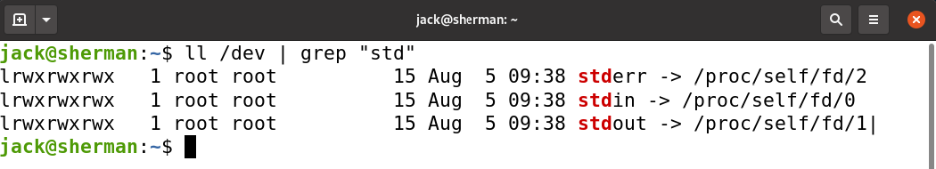
Redirecting stdin, stdout, stderr
For programs that access stdin, stdout, and stderr,
bash, by default, initializes
stdin to /dev/stdin, defaulting /dev/stdin to /dev/tty
stdout to /dev/stdout, defaulting /dev/stdout to /dev/tty
stderr to /dev/stderr, defaulting /dev/stderr to /dev/tty

Slide 43
Redirecting stdin, stdout, stderr
For programs that access stdin, stdout, and stderr,
bash also supports the use of special command-line syntax to reroute these input and output streams, a feature known as redirection

Slide 44
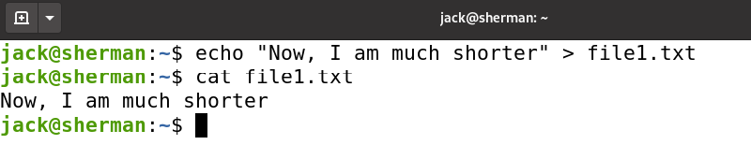
Unix I/O Redirection Operators
Unix provides seven basic redirection operators
cmd < infile – redirect cmd's input from file infile to stdin
cmd > outfile – redirect cmd's output from stdout to file outfile, potentially overwriting outfile if outfile already present
cmd >> outfile – redirect cmd's output from stdout to file outfile, appending it to outfile if outfile already present

Slide 45
Unix I/O Redirection Operators
Unix provides seven basic redirection operators
cmd 2> errlog – redirect cmd's output from stderr to file errlog, potentially overwriting errlog if errlog already present
cmd 2>> errlog – redirect cmd's output from stderr to file errlog, appending it to errlog if errlog already present
cmd &> outfile – redirect cmd's output from stdout and stderr to file outfile, potentially overwriting outfile if outfile already present
cmd &>> outfile – redirect cmd's output from stdout and stderr to file outfile, appending it to outfile if outfile already present

Slide 46
Rules for Using Redirection Operators
Redirection always accompanies some command: e.g.,
> outfile makes no sense as a standalone command
cat > outfile , on the other hand, does

Slide 47
Rules for Using Redirection Operators
Different redirections may be combined, with an effective limit of one redirection per stream per command
The following, for example, are valid combinations of redirections:
cat < infile > outfile
cat < infile > errlog
cat > outfile 2 > errlog
cat < infile > outfile 2>errlog
cat < infile &> outfile
When two or more redirections of a common stream are paired with a command, bash appears to ignore all but the last: e.g.,
cat < baz > foo > bar creates foo as an empty file and bar as a copy of baz

Slide 48
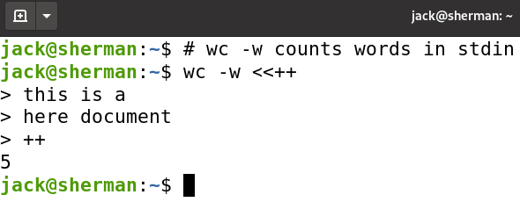
Input Redirection: "Here" Documents
Two bash operators enable redirection of in-line content to stdin
<<delimiter\n, accepts content up to and including a line that contains just the delimiter
delimiter can be any character string other than – and <
<<-delimiter\n, is like the first, except that
delimiter can be any character string other than <
it also strips leading tabs from input lines

Slide 49
Input Redirection: "Here" Documents
Content entered between the initial redirection operator and the final delimiter is known as a here document
<< and <<- are useful for embedding documents in scripts

Slide 50
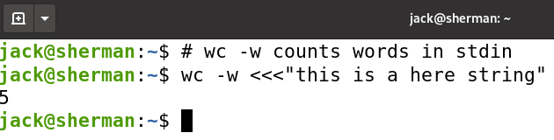
Input Redirection: "Here" Strings
A variant of a here document, a here string, is a string that follows a <<< operator
This construct can prove useful in a variety of contexts, including the construction of simple examples for slide sets like these

Slide 51
Redirection: Pragmatics
There are lots (!) of ways to use redirection to create new files: e.g.,
cat infile > newfile
cat < infile > newfile
cat < /dev/tty > newfile
Terminate typein with Ctrl-D (or Ctrl-C)
use echo stuff > newfile to write stuff directly to file
redirect stdout from any output-producing command to new file

Slide 52
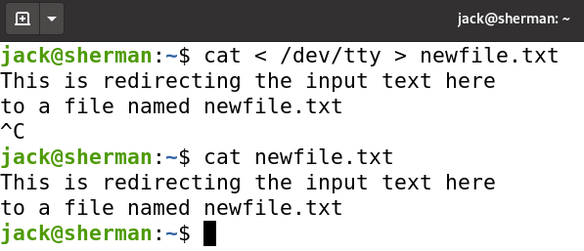
Redirection: Pragmatics

Slide 53
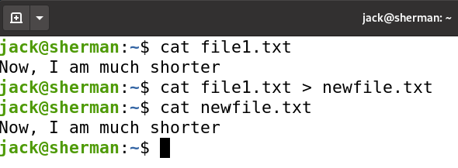
Redirection: Pragmatics

Slide 54
Redirection: Pragmatics
Output redirection, by default, overwrites existing files
Overwriting is enabled with bash's set +o noclobber command (default)
Overwriting can be suppressed with bash's set -o noclobber command

Slide 55
Redirection: Pragmatics
Avoid &> for "serious" scripts
Unix administrators commonly use scripts to automate routine procedures for system administration
For scripts that run automatically (and most should), it's a best practice to
separate error messages from good output, so the two can be readily distinguished
save error messages to a log, so they can be reviewed and addressed at an admin's convenience

Slide 56
Usage

Slide 57
Usage
A lot of what we’ve covered here may seem trivial
Where it really comes into play, as has been mentioned before (and as we’ll see in the future) is in the creation of scripts
Bash provides a rich (if somewhat archaic) scripting environment
Allows us to automate common tasks
You’ll hear me say this in CSCI 4417 (where we do a lot more Linux!): “A good System Administrator is one who scripts him/herself out of a job”

Slide 58
Usage
A key difference between Unix/Linux and Windows is that, in Windows, everything is object-oriented
With Unix and Linux, everything is string-oriented
So, in this class, learning how to make strings ‘sit up and beg’ is essential

Slide 59


